Slide 1


Cincinnati PowerShell User Group PowerShell Summit – What’s afoot in the PowerShell community?
Twitter - @CincyPowerShell
Email CincyPSUG@outlook.com

Slide 2

PowerShell And DevOps Summit Recap
https://devopscollective.org/
Announcing the “GetGoing” IT Ops Education Program & Scholarship
DSC is maturing
https://github.com/PowerShellOrg/dsc-summit-precon
PowerShell Team ‘s PowerShell Community
Pester – if you don’t know it – learn it!
DevOps is real and its not just for *Nix
The Release Pipeline Model
Notes:
Educate, Launch, Connect, Support
First, it’s a Model Curriculum
Second, it’s Actual Education
Third, it’s a Scholarship
It’s a significant program, worth around $11,000 per student. For 2016, it will be open to legal residents of the United States aged 17 – 30
DSC – Lots of production use. Talked to AWS Infrastructure developer – DSC is in full production, over 300 DHCP servers,

Slide 3
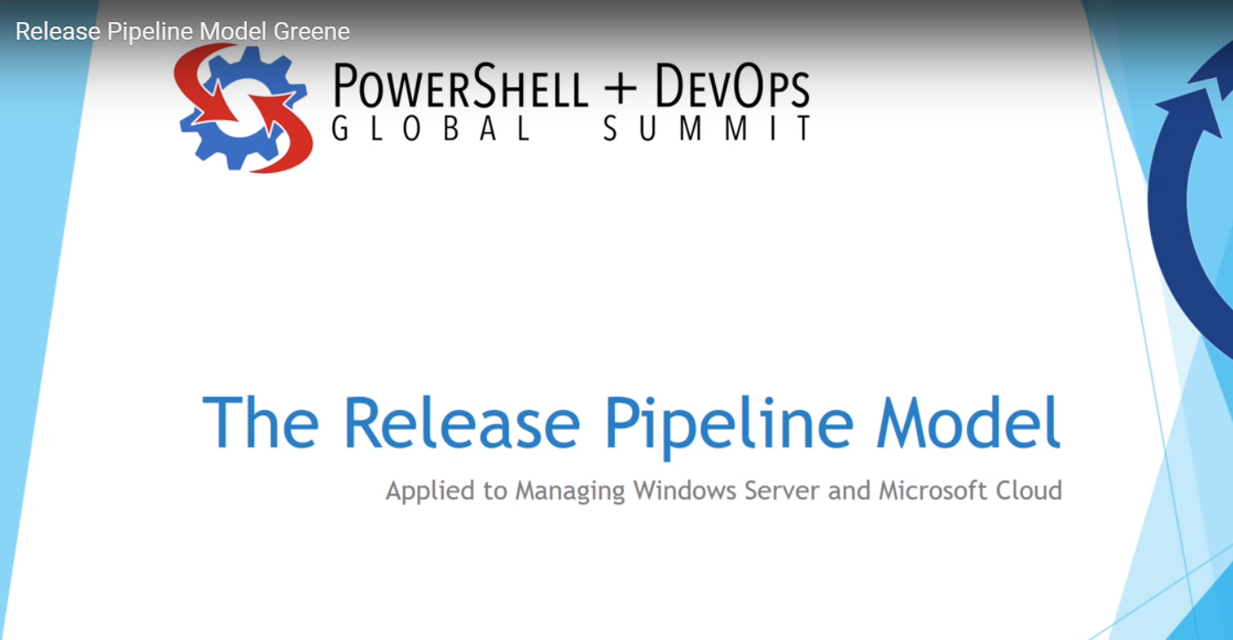

Slide 4
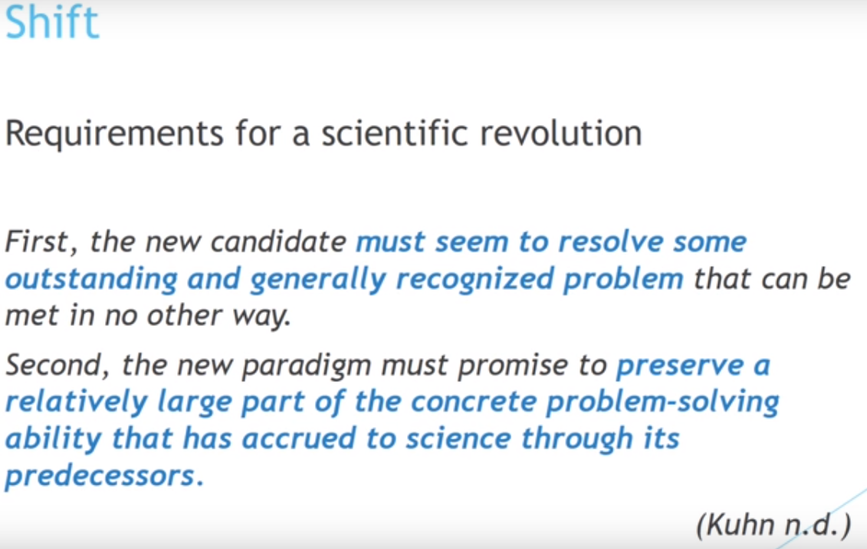
Notes:
DevOps is a paradigm shift in the industry, but if we can’t make it a solution for what we are doing today, it won’t take hold and become a revolution. This is where most windows shops are sitting today. We get the tenants, but don’t feel like the tools are there, the support is there, or the culture is there.

Slide 5
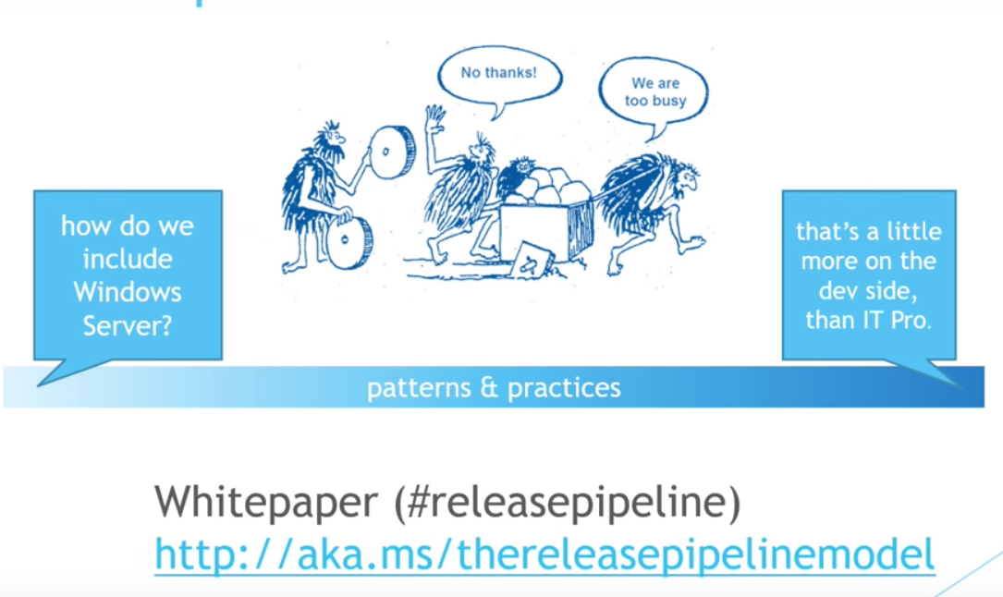
Notes:
A whole spectrum of Devops. On one side you have the people that are doing it, but they aren’t sure how to fold in the windows infrastructure. On the other side, you have near 100% windows shops, that say, whoa! Pump the breaks, that stuff is for Dev’s, we are Ops guys. How many of you are the champions of scripting and automation on your teams? What is the push back (I don’t have time?, That would be great….but. Once I get all this stuff done…I’ll have time for that…) But there are a lot of folks in the middle, I suspect that you are here tonight because your somewhere in the middle. That is why Michael Greene and Steve Murawski released this paper. It’s for us. The people that are in the trenches, that care about Automation. That are interested in making things better / faster / more secure / and more reliable.

Slide 6
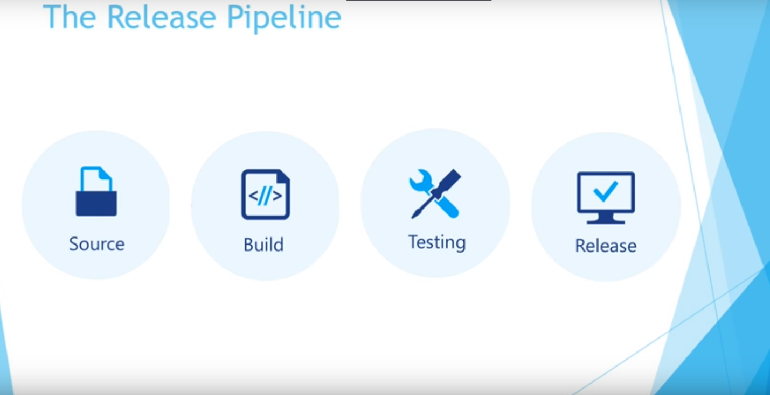
Notes:
The concept is simple, we are familiar with this in the terms of Application development. You write code, you compile it, you test it, and then you release it. For ITPro’s it’s hard to relate it to Infrastructure. The paper focus on these 4 core concepts, for ITPro’s not Devs.
Source – We’ve gone over this before This is Source Control. How do we put our IT infrastructure in code?
Build –
Testing –
Release -

Slide 7
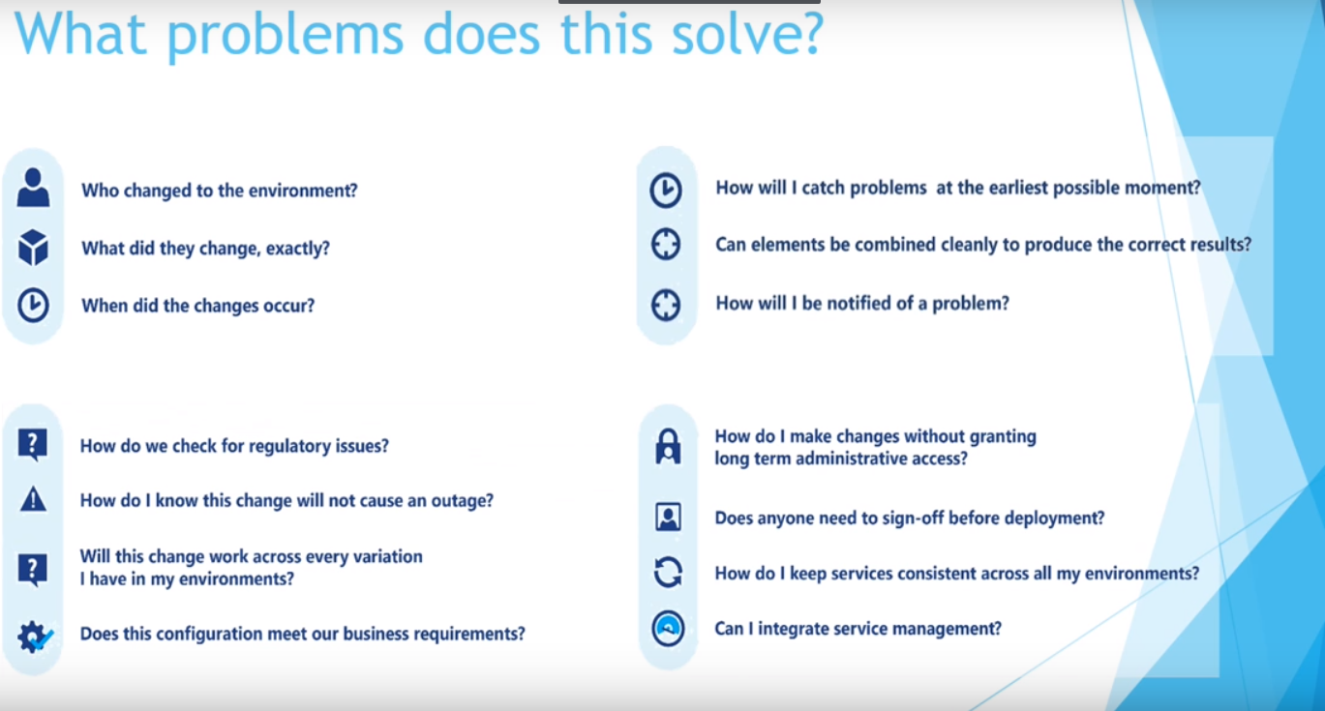

Slide 8
Source - What we did before
http://www.youtube.com/watch?v=bRd0XiMIRMs&t=14m30s
Notes:
Update config file – DSC / Chef / Puppet (script, registry key, web config file, software installation etc…)
Clone code to your workstation
Make your changes
Run tests – Pester!
Push to Source control

Slide 9
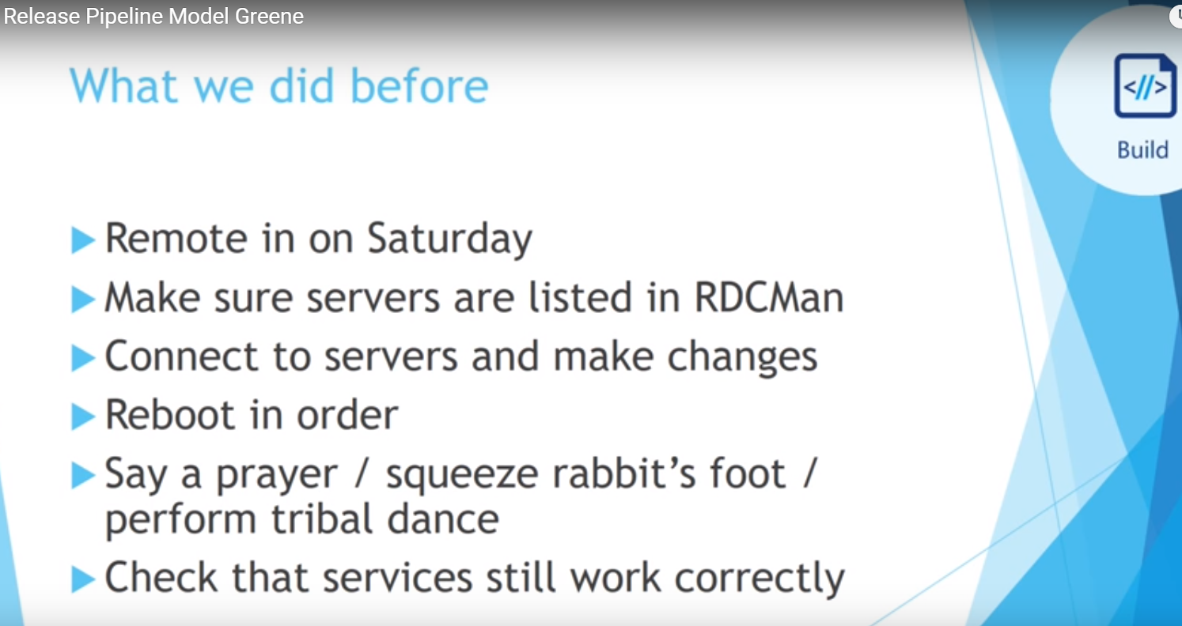
Notes:
Is this your Build process? This is mine. For most Win ITPro’s this is our life. How do we break this cycle???

Slide 10
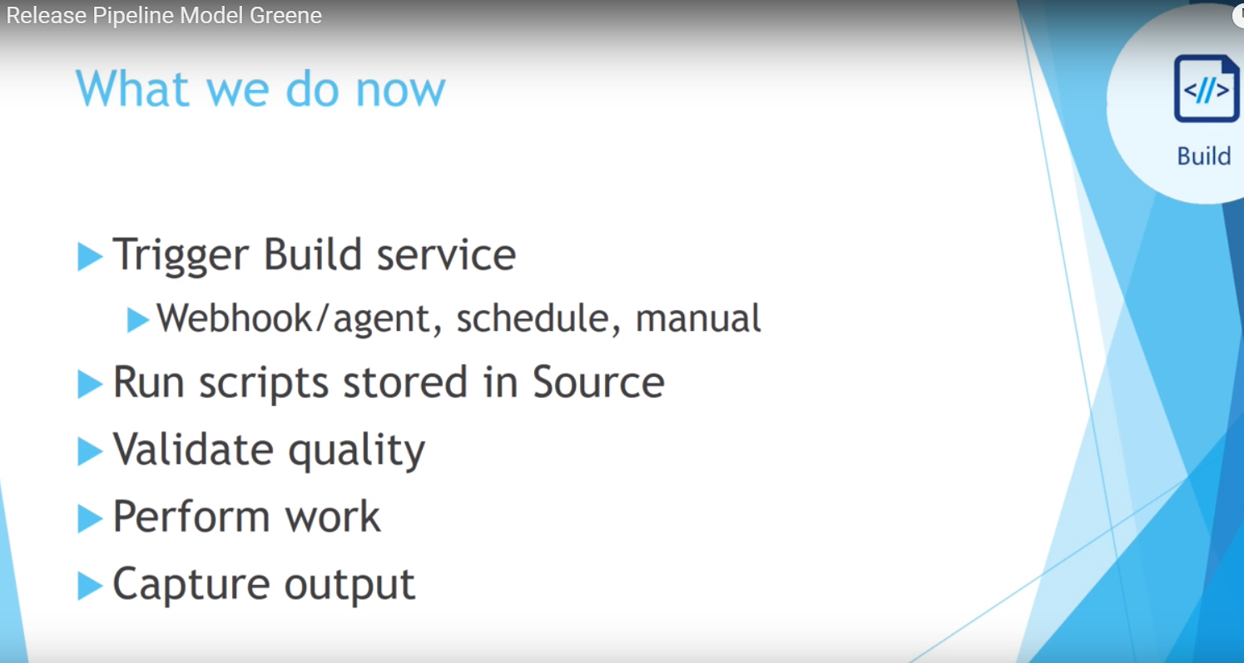
Notes:
After we pass our local tests and check in our code (appveyor build passed in github)
Every time you check in, you test and build, ensuring that you are always shippable (we aren’t shipping apps, were shipping infrastructure)

Slide 11
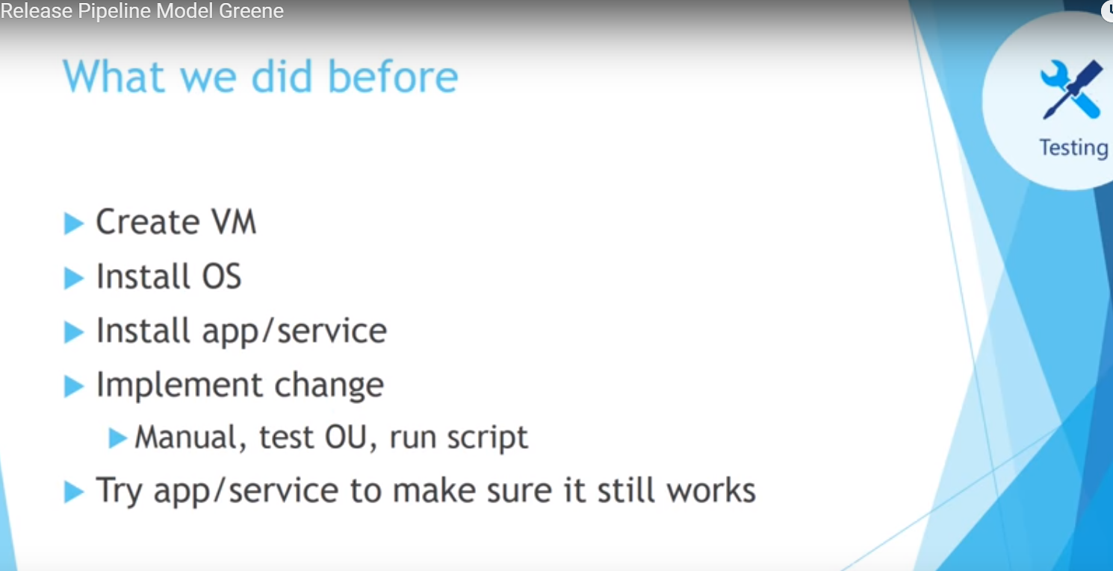
Notes:
Testing – how are you testing your infrastructure changes today? Do you test, do you know what to test? Are there situations where time and time again, the tests are fine, but there is a gap in the test and issues arise.

Slide 12
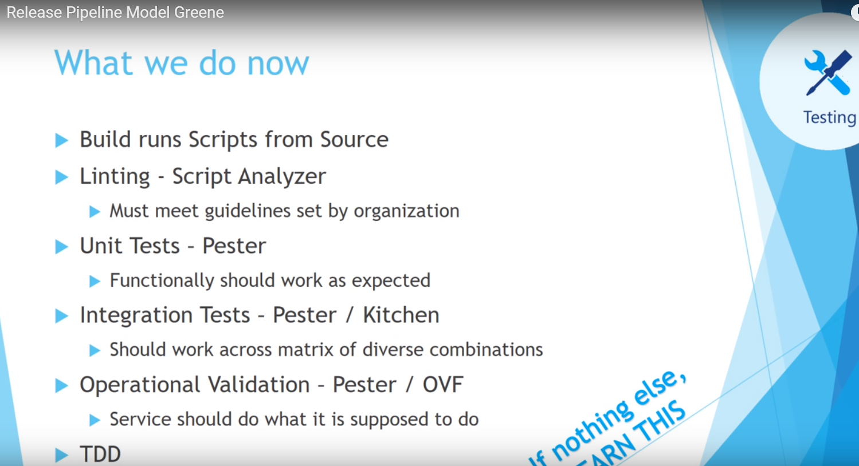

Slide 13
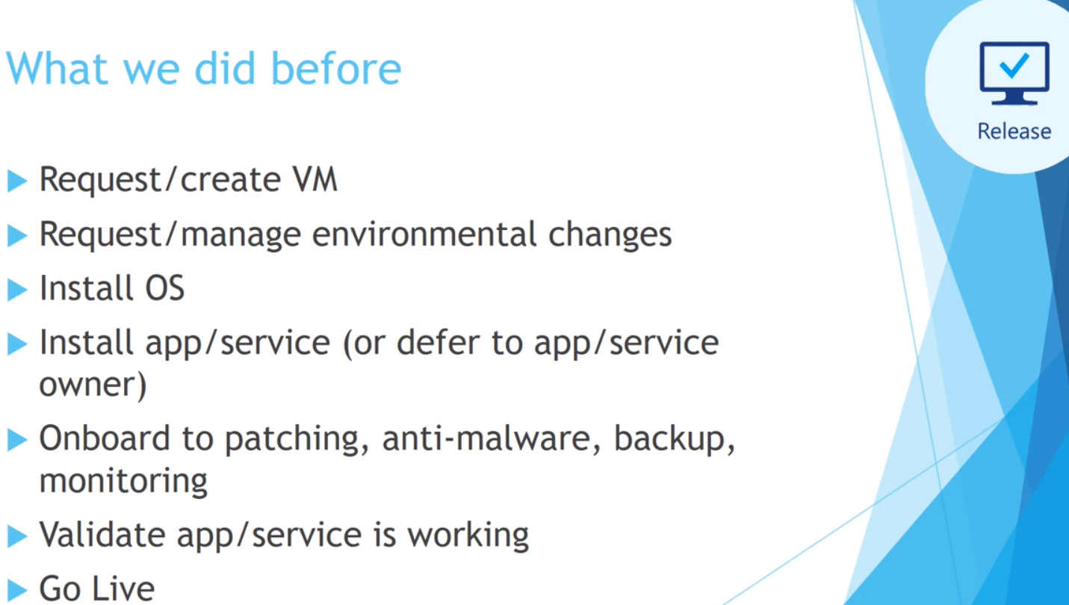

Slide 14
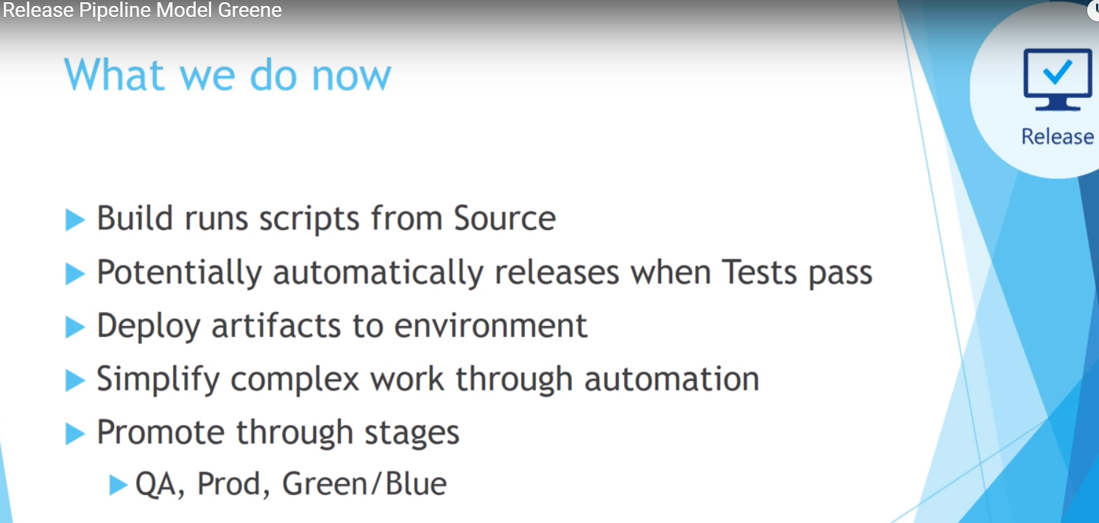

Slide 15
What’s next? Where do I start?
Powershell – Obviously!
Source Control (just install git, and then run git init in your Scripts folder, Done!)
DSC – If your not learning it, start!
Chef / Puppet – Tooling is essential, DSC is only part of the picture
Pester, psDeploy, psake, Operational Validation Framework

Slide 16
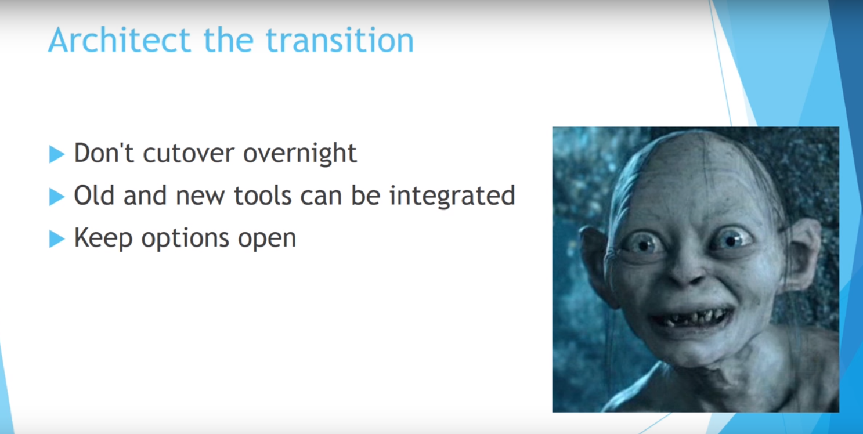

Slide 17
Resources
https://devopscollective.org/
DSC Precon Content - https://github.com/PowerShellOrg/dsc-summit-precon
The Release Pipeline Model – http://aka.ms/thereleasepipelinemodel - All slides stolen from @migreene and @StevenMurawski – Thanks!
PSHSummit 2016 Youtube Channel https://www.youtube.com/playlist?list=PLfeA8kIs7Coc1Jn5hC4e_XgbFUaS5jY2i
PSDeploy - https://github.com/RamblingCookieMonster/PSDeploy
Psake - https://github.com/psake/psake
Operation Validation Framework - https://github.com/PowerShell/Operation-Validation-Framework
Chef - https://learn.chef.io/

Slide 18
Resources - continued
Pester resources
https://github.com/pester/Pester
Getting started - https://www.simple-talk.com/sysadmin/powershell/practical-powershell-unit-testing-getting-started/
http://www.powershellmagazine.com/2014/03/12/get-started-with-pester-powershell-unit-testing-framework/
Pester in Action - https://www.youtube.com/playlist?list=PLOcTmsj9WHDo2_FfKePLaq_mJTcnW_fEJ
Boe Prox – OPSUG https://learn-powershell.net/2015/11/16/resources-available-from-my-talk-on-powershell-and-pester/

